Slide 1
출튀는 안돼요 + 알리미
[산학캡스톤디자인1]
8팀 : 임현택(팀장), 김재서, 이선홍, 이승오

Slide 2
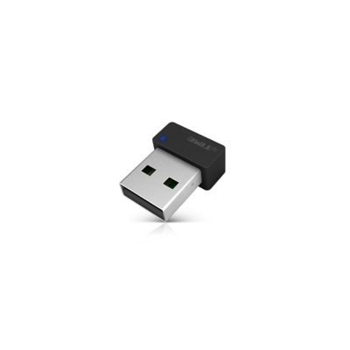
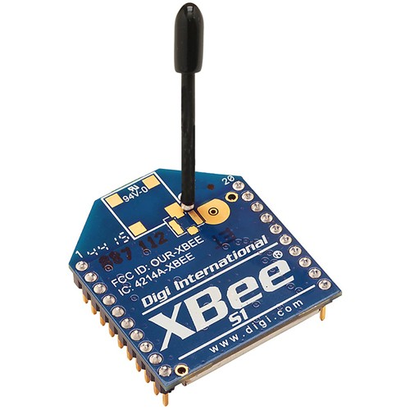
XBee Module -> LAN card

Slide 3

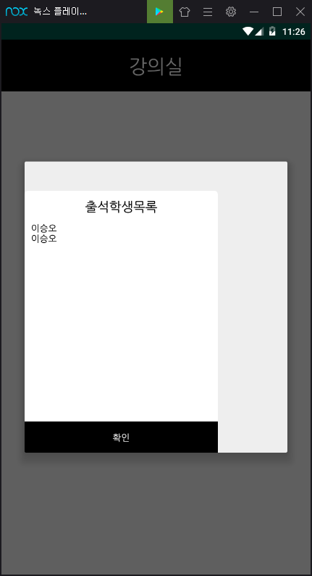
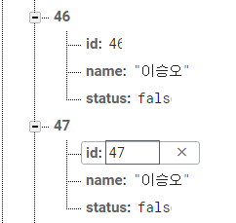

Solved
Database be overlapped
Modified DB and Android source code

Slide 4
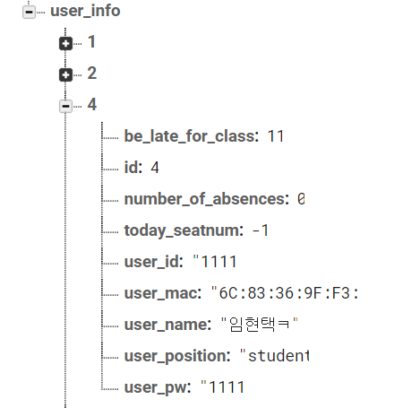
Problem 1
The value of
the ‘number_of_absences’
does not change.
For reference,
5 escapes = 1 be_late_for_class
2 be_late_for_class = 1 number_of_absences

Slide 5
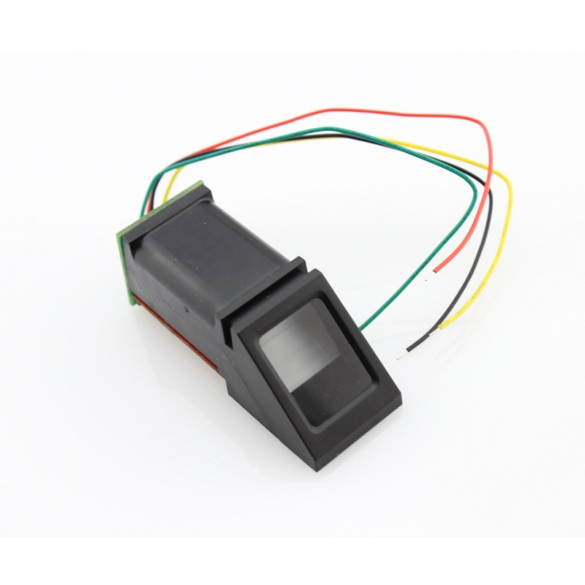
Problem 2
Don’t use Fingerprint sensor

Slide 6
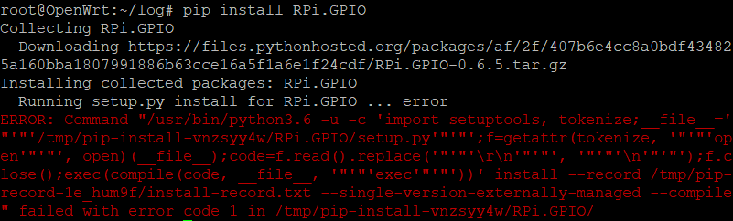
Not support RPi.GPIO module in OpenWrt
Thus, Added RPI for H/W control

Slide 7
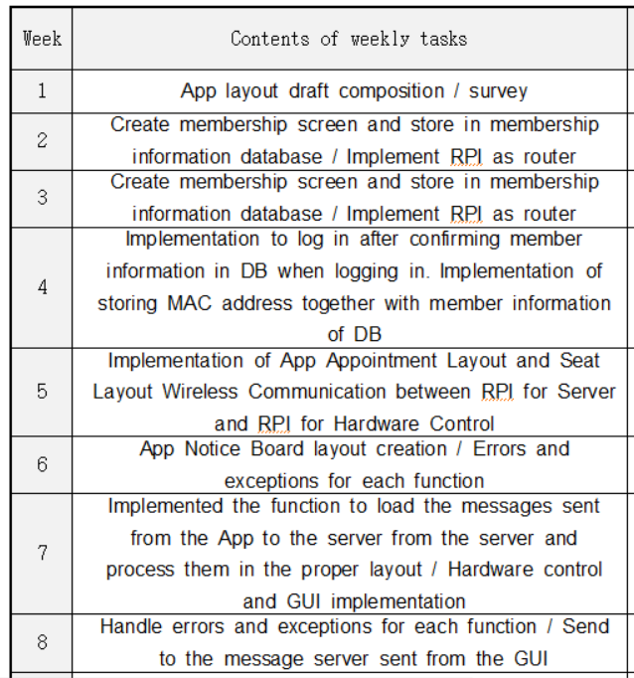
Schedule & Progress Check

Slide 8
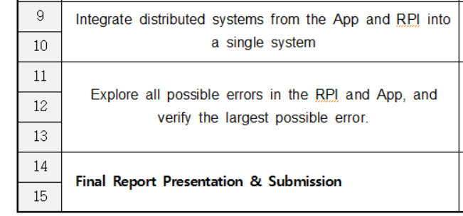
Schedule & Progress Check

Slide 9
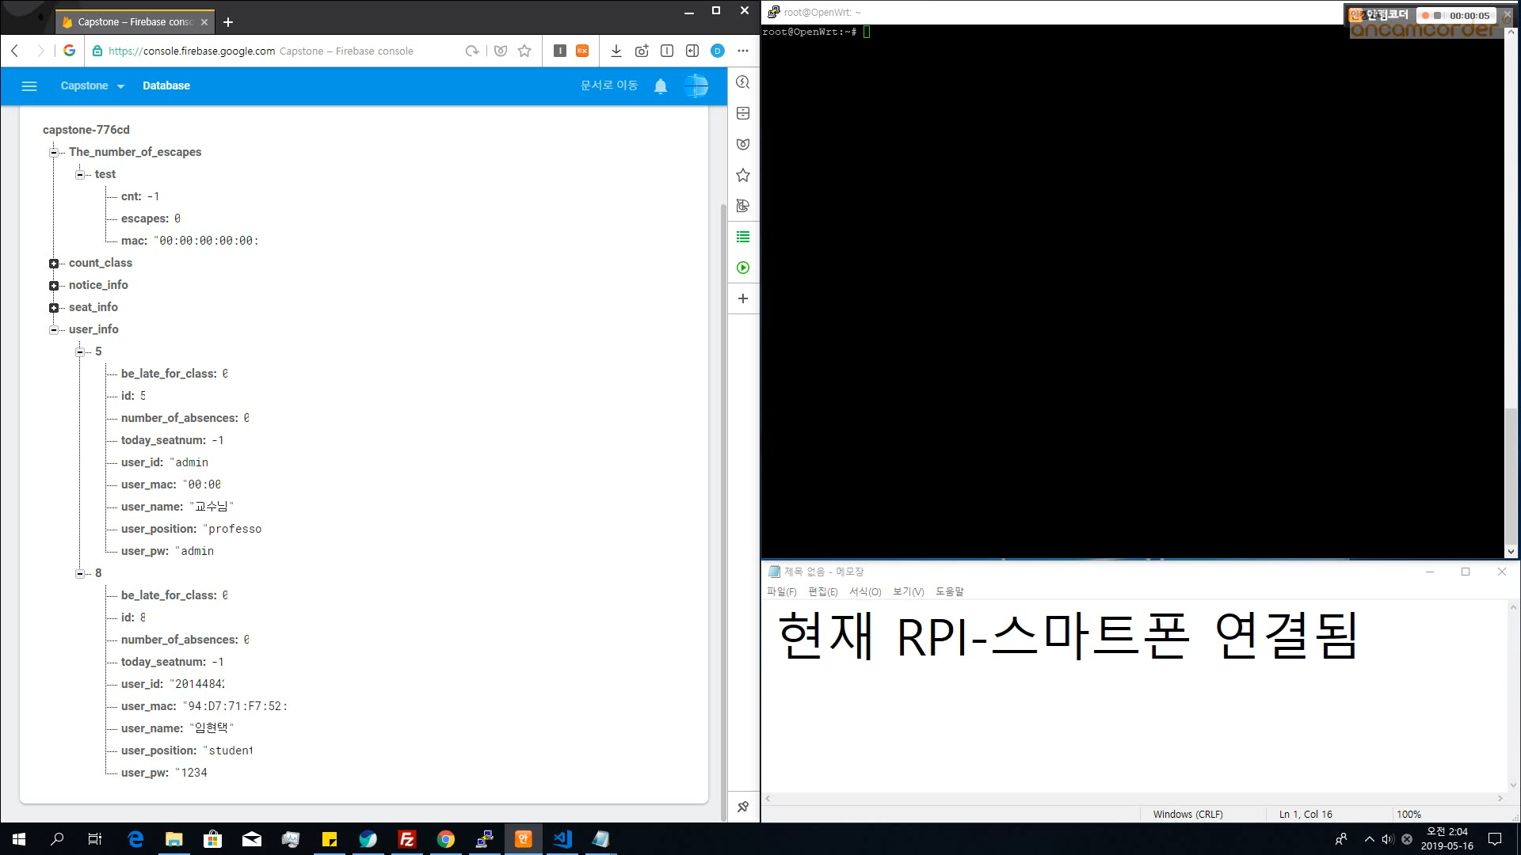
Demo video 1

Slide 10
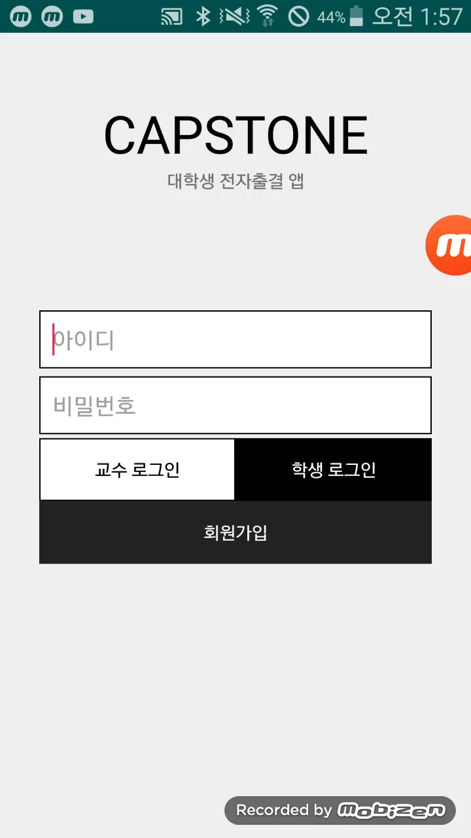
Demo video 2

Slide 11
Testing

Slide 12
Q&A
https://github.com/devLupin/Capstone1

